Slide 1

Creating a Fake News Detection System using AI
As fake news becomes more prevalent, an AI system can aid in the fight against misinformation. This presentation covers the development of such a system.

Slide 2

Problem Definition
The problem is to develop a fake news detection model using a Kaggle dataset. The goal is to distinguish between genuine and fake news articles based on their titles and text. This project involves using natural language processing (NLP) techniques to preprocess the text data, building a machine learning model for classification, and evaluating the model's performance.

Slide 3

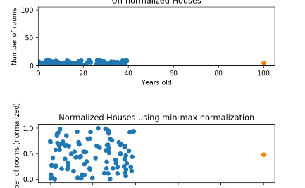
Data Preprocessing
Raw data needs cleaning and normalization to ready it for use by AI models. This can take up a significant portion of the development time.
Data Normalization
Data Cleaning
Convert data into a standard format, making it easy to understand by the machine, by converting date formats or categorical data.
Remove unwanted characters, stop words, and normalize the text to convert it into a machine-readable format.

Slide 4
Feature Extraction
Feature extraction is the process of converting text data into numerical features that machine learning models can understand. It plays a crucial role in building an effective fake news detection system.
TF-IDF
Word and Sentence Embeddings
Topic Modeling
TF-IDF is a technique that quantifies the importance of words in a document relative to the entire corpus. It results in a numerical representation of the text..
Extracting topics relevant to the dataset and using topic frequency to create significant data clusters.
Applying vectorization techniques to convert words into numbers and find the semantic meaning of words or sentences.

Slide 5
Model Selection
Choosing the right model architecture is crucial to create a powerful detection system.
1
Rule-based Models
Uses predefined rules to distinguish between fake and factual news. This model is highly interpretive, but may not be as accurate as other models.
Machine Learning Models
2
Uses algorithms that learn from data to identify patterns and make predictions. Random Forests, SVM and logistic regression are popular choices.
3
Deep Learning Models
Uses neural networks to learn from data in an unsupervised manner. This model is sample-efficient and is highly accurate in detecting fake news.

Slide 6

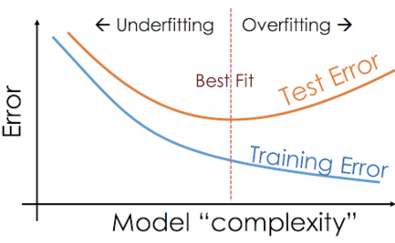

Model Training
Training an AI model for fake news detection involves feeding the preprocessed data into a chosen model repeatedly, until the model reaches high accuracy.
Training
Overfitting
Optimization
Feed the preprocessed dataset into the model repeatedly and alter the parameters until accuracy is high.
Evaluate the performance by testing the model on data the model hasn't seen before. Avoid overfitting at all costs.
Optimize the model to achieve its peak performance level by fine-tuning its parameters and hyperparameters.

Slide 7


Evaluation
The final AI model needs to be put through its paces, evaluated for speed and accuracy, and integrated into existing systems.
1
Accuracy
2
Speed
How accurately does the model detect fake news?
How fast can the model detect fake news?
3
Integration
Can the model integrate with existing news systems? Ease of deployment.

Slide 8

Conclusion
The ultimate goal of creating an AI-powered fake news detection system is to promote information transparency and curb misinformation. It's a challenging process with many intricate steps, as detailed in this presentation.

